Slide 1
SFML project
Platformer game

Slide 2
Features
Player
Fireball
Gold bag
Platforms
Background
Heart

Slide 3
Gameplay part 1
The game allows the Player to move in four directions. The number of Platforms in the game depends on its difficulty level. Fireballs move from left to right, and the player's main objective is to avoid them. By collecting randomly appearing Gold bags, the Player can earn bonus points.

Slide 4
Gameplay part 2
If a Fireball hits the Player, they will lose one of their remaining Lives. Initially, the player starts with three lives. The Player can regain health by collecting Hearts that appear at random positions, but these Hearts are only available for five seconds. If the player loses all remaining lives the Game will be over.

Slide 5

Pre-game interface

Slide 6
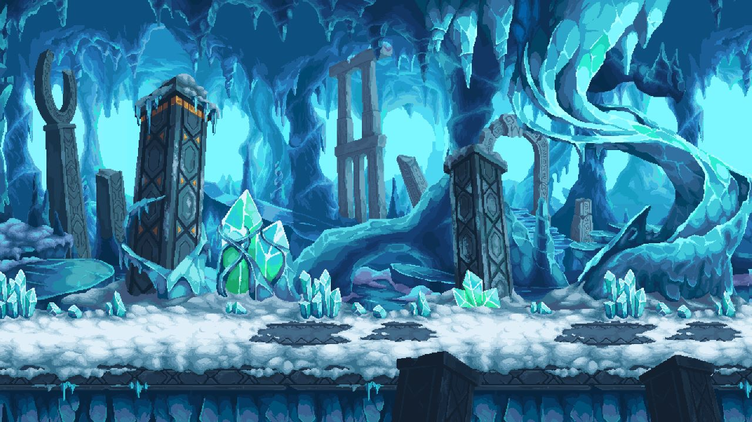
Sprite - Background

Slide 7

Sprite - Character

Slide 8

Sprite - Gold bag

Slide 9

Sprite - Ground

Slide 10

Sprite - Platforms

Slide 11

Sprite - Platforms and Ground

Slide 12

Sprite - Heart

Slide 13

Sprite - Shaded Heart

Slide 14
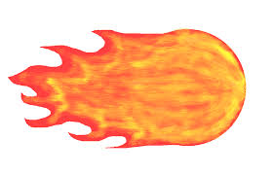
Sprite - Fireball

